Slide 1
APPLIED AI DESIGN WORKSHOP
DAY 5
DAY 5
From Machine Learning
to AI-Enabled Workflows
Today’s focus
Turn Day 3–4 model results into AI-ready evidence and reproducible, validated workflows.
Evidence packages • AI-assisted pipelines • Guided LLM prompts • Human validation
Output
A grounded AI workflow concept and a prompt-chain approach for recreating an ML notebook.
Applied AI Design Workshop for Faculty
Fred Livingston (fjliving@ncsu.edu) 2026
1

Slide 2
APPLIED AI DESIGN WORKSHOP
DAY 5
Where we are in the workshop
Day 5 connects the foundational machine-learning workflow to AI-assisted implementation and interpretation.
DAY 3
Problem framing
Regression
DAY 4
Classification
Data preparation
DAY 5
AI assistance
Validated workflows
NEXT
Apply to teaching
research workflows
Progression
From building a defensible first-pass ML analysis → to using AI as a copilot for evidence-grounded communication, notebook generation, and workflow design.
Key shift: the LLM does not create new evidence; it helps organize, explain, and implement evidence that faculty can validate.
2

Slide 3
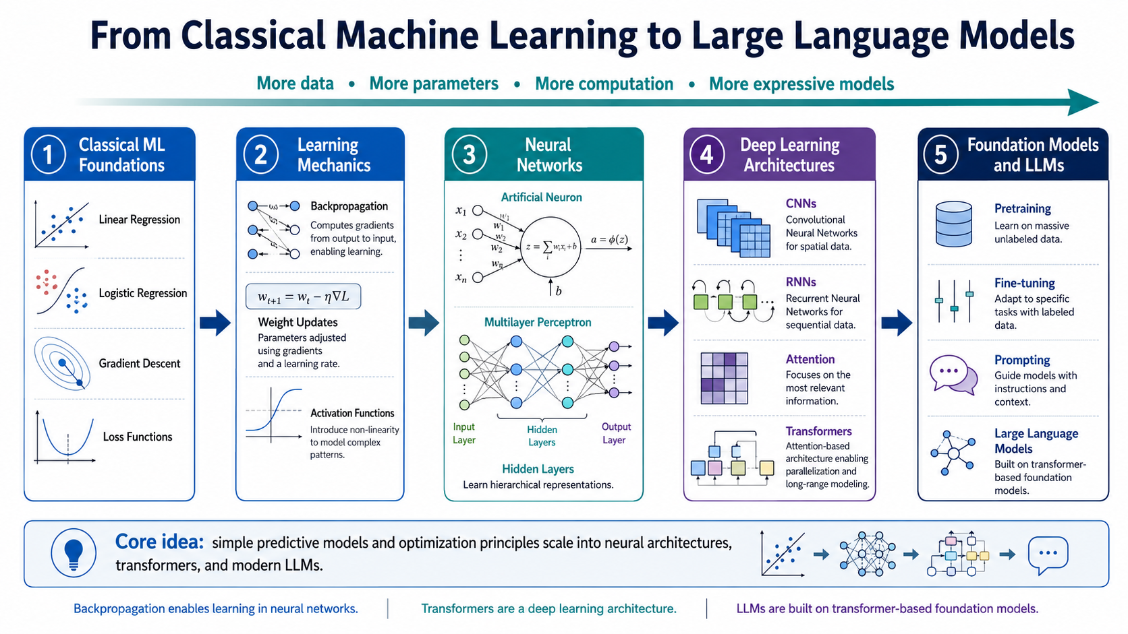
APPLIED AI DESIGN WORKSHOP
DAY 5
Day 3 recap: ML foundations and problem framing
Day 3 established the vocabulary and structure needed to create defensible ML problems.
Problem framing
Classic ML landscape
Regression
Baseline thinking
Participant output
Prediction objective
Inputs and outputs
Unit of observation
Target variable
Regression
Classification
Clustering
Forecasting
Anomaly detection
Linear models
Polynomial trends
Regularization
Residuals and MAE/RMSE
Mean or majority baseline
Metric selection
Practical success criteria
A framed ML problem with inputs, target, baseline, and metric.
• Every AI workflow still needs a clear unit of observation and target or discovery question. • Baselines and metrics become the evidence that an AI explanation must respect. • LLM-generated conclusions must be checked against the original ML framing.
What carries forward to Day 5?
3

Slide 4
APPLIED AI DESIGN WORKSHOP
DAY 5
Day 4 recap: from classification to data preparation
Day 4 expanded the workflow from supervised classification to data cleaning, feature preparation, and unsupervised discovery.
1
Classification
2
Baseline model activity
3
Data preparation
4
Unsupervised discovery
Predicted categorical outcomes using logistic regression, decision trees, probabilities, thresholds, and confusion matrices.
Built a first-pass model workflow with data inspection, baselines, simple models, metrics, and interpretation.
Addressed missing values, outliers, data types, encoding, scaling, leakage, and domain-informed features.
Used clustering, PCA, silhouette scores, DBSCAN, and cluster profiles to explore unlabeled data.
Day 4 generated the evidence packets that Day 5 will use:
Metrics
Visuals
Decisions
Limits
accuracy • recall • F1 • silhouette
confusion matrices • PCA plots
features • leakage • thresholds
data quality • validation • claims
4

Slide 5
APPLIED AI DESIGN WORKSHOP
DAY 5
Transition: model results are not yet an AI workflow
Day 5 asks how predictive evidence becomes context for AI-assisted analysis, communication, and notebook generation.
Data
Baseline
Model
Metrics
Evidence
package
LLM
workflow
Human
review
Day 5 working principle
AI is useful when it is grounded in explicit evidence and constrained by human-validated assumptions, metrics, and limitations.
Do not ask only
Ask instead
“Can AI explain this?”
“What evidence can AI use, and what must it not claim?”
5

Slide 6
APPLIED AI DESIGN WORKSHOP
DAY 5
Day 5 schedule
BLOCK
FOCUS
Welcome and Day 5 framing
Connect Day 3–4 work to AI-enabled workflows
Session 1 — Evidence package synthesis
Problem, dataset, baseline, results, limitations, claim boundaries
Session 2 — AI across the full ML pipeline
Framing, audit, leakage, features, pipeline, evaluation, communication
Invited presentation — LLM and AI Workflows on NCSU’s Hazel HPC
Scalable AI workflows and university computing resources
Break
Session 3 — Guided LLM prompt chain
Seven-step prompt sequence with guardrails and human checkpoints
Session 4 — Worked example: recreate the ML notebook
Prompts → notebook → baseline/model results → model card → validation checks
Open discussion, questions
Faculty applications, technical questions, next steps
6

Slide 7
APPLIED AI DESIGN WORKSHOP
DAY 5
Day 5 learning objectives
By the end of Day 5, you should be able to use AI to support—not replace—a defensible ML workflow.
1
Synthesize evidence
2
Map AI utility
3
Prompt with guardrails
Convert Day 3–4 results into an evidence package that includes metrics, visuals, limitations, and claim boundaries.
Identify where AI can assist with problem framing, data auditing, leakage review, feature generation, code, evaluation, and explanation.
Use a guided prompt chain to generate notebook-ready markdown and code while preventing invented columns and unsupported claims.
4
Audit generated artifacts
5
Communicate responsibly
6
Connect to implementation
Check LLM-generated notebooks for leakage, preprocessing errors, metric mismatch, hallucinations, and causal overclaims.
Produce audience-specific explanations and model-card summaries grounded in evidence and explicit limitations.
Identify how AI workflows could support teaching, research, or lab operations while preserving human review.
Day 5 success criterion: participants can inspect, run, and defend AI-assisted ML artifacts.
7

Slide 8
APPLIED AI DESIGN WORKSHOP
DAY 5
Today’s learning activities
The activities are designed to move from evidence to implementation while keeping faculty in control of the analysis.
A
Evidence package
B
AI pipeline map
C
Prompt chain
D
Worked example
Turn prior ML results into structured context that an AI system can use without inventing claims.
Identify which stages are accelerated by AI and which require human validation or domain expertise.
Use seven controlled prompts to create notebook sections, code, metrics, interpretation, and a model card.
Follow a complete defect-classification example from prompt to notebook to validation checks.
Learning mode
Instructor demo
Faculty audit
Discussion
Show the evidence → prompt → notebook → validation workflow.
Identify invented columns, leakage, metric mismatch, and causal overclaims.
Translate the workflow to faculty research, teaching, and lab contexts.
Key phrase for the day: AI drafts the artifact; validate the assumptions, workflow, metrics, and claims.
8

